Slide 1
OS Project
Mid-Semester Progress Presentation

Slide 2
ThreadMentor: The Dining Philosophers Problem

Slide 4
Introduction
The Dining Philosophers Problem was introduced by E. W. Dijkstra as a classic example of synchronization in concurrent programming.
It involves five philosophers who alternate between thinking and eating, with five chopsticks shared between them.
The challenge: ensuring safe access to shared resources (chopsticks) while avoiding deadlock and starvation.

Slide 5
Project Goals
Implement a multi-threaded solution for the Dining Philosophers Problem using ThreadMentor.
Utilize mutex locks to synchronize access to shared chopsticks.
Analyze potential issues like deadlock and starvation, and explore possible solutions.

Slide 6
MUTEX Solution
https://pages.mtu.edu/~shene/NSF-3/e-Book/MUTEX/TM-example-philos-1.html

Slide 7
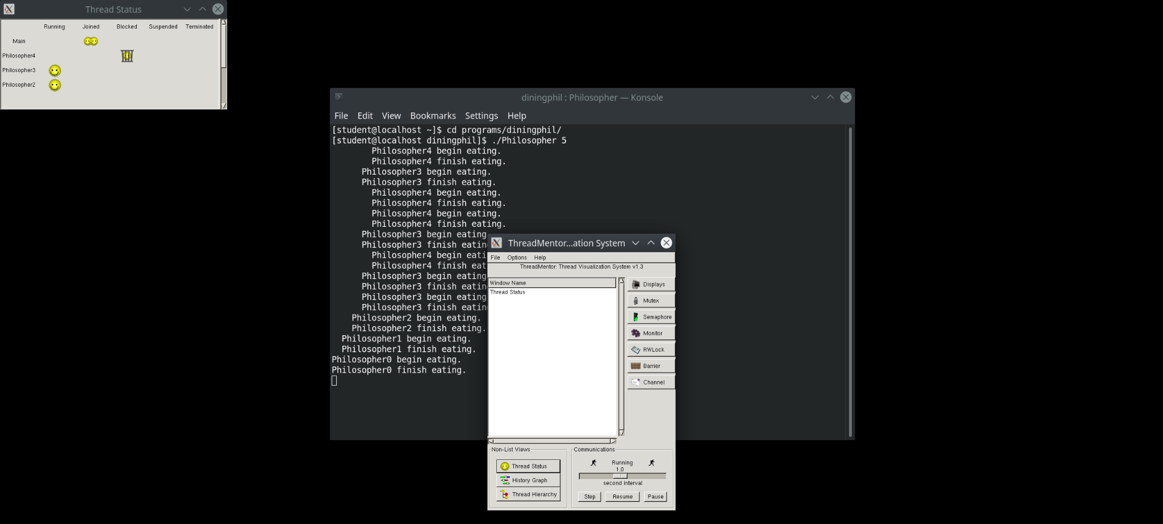
Program run

Slide 8
Implementation Details

Slide 9
Implementation Details
Thread Management
Each philosopher is represented as a separate thread.
The Philosopher class extends the Thread class, defining individual behaviors.
The ThreadFunc() method controls the thinking-eating cycle.

Slide 10
Implementation Details
Resource Synchronization
Each chopstick is protected by a mutex lock (Mutex *Chopstick[PHILOSOPHERS]).
A philosopher locks their left chopstick first, then the right chopstick before eating.
After eating, both chopsticks are released.

Slide 11
Implementation Details
Main Program Execution
Initializes mutex locks for chopsticks.
Creates and starts five philosopher threads.
Ensures all threads complete execution using Join().

Slide 12
Challenges and Observations

Slide 13
Challenges and Observations
Deadlock Possibility
If all philosophers pick up their left chopstick at the same time, a circular wait occurs.
None can pick up their right chopstick, leading to deadlock.

Slide 14
Challenges and Observations
Starvation Risk
Faster philosophers can monopolize chopsticks, preventing slower ones from eating.
Leads to an unfair system where some philosophers never get a chance to eat.

Slide 15
Possible Solutions

Slide 16
Possible Solutions
Avoiding Deadlock:
Enforce an ordering rule (e.g., the last philosopher picks up their right chopstick first).
Use a waiter (semaphore) to allow only four philosophers to sit at a time.
Preventing Starvation:
Use a fair scheduling policy, ensuring no philosopher waits indefinitely.
Introduce timeouts when acquiring locks.

Slide 18
Next Steps
Code Solution: Focus on deep understanding of code solution.
Documentation & Report Submission: Complete the final team report with proper citations.
Presentation Preparation: Refine slides, rehearse the presentation, and anticipate possible questions.

Slide 19
Conclusion
The project successfully implements multi-threaded synchronization using ThreadMentor.
Challenges like deadlock and starvation require strategic solutions for optimal performance.
Through ThreadMentor visualization, we gained deeper insights into process interactions and performance.
This project strengthened our understanding of operating system concepts and practical implementation of thread synchronization.

Slide 20
© 25/03/2025 | Danyil Tymchuk & Artem Surzhenko & Emanuel Avram

